Slide 1
- Scoring and Term Weighting
- The Vector Space Model

Slide 2
Contents
Parametric and zone indexes
Ranked retrieval
Term Weighting schemes
Vector space scoring

Slide 3
Parametric and zone indexes
Each document has, in addition to text, some “meta-data” in fields e.g.,
  Language = French
  Format = pdf
  Subject = Physics etc.
  Date = Feb 2000
A parametric search interface allows the user to combine a full-text query with selections on these field values e.g.,
  language, date range, etc.
Fields
Values

Slide 4
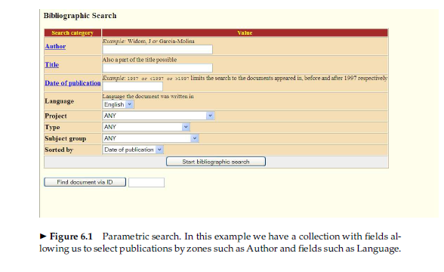
User view

Slide 5
Zones
A zone is an identified region within a doc
  E.g., Title, Abstract, Bibliography
Contents of a zone are free text
  Not a “finite” vocabulary
Indexes for each zone - allow queries like
  find documents with merchant in the title and william in the author list and the phrase gentle rain in the body

Slide 6

Zone indexes – simple view
etc.
Title
Author
Body

Slide 7
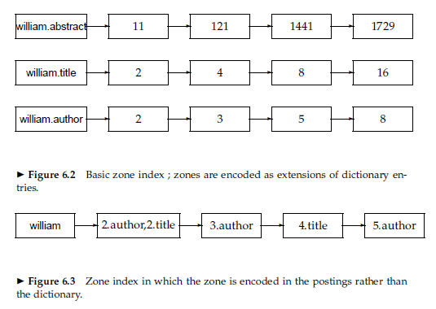
Zone indexes – common view

Slide 8
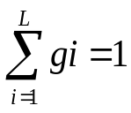
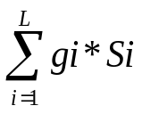
Weighted zone scoring
Given a Boolean query q and a document d, weighted zone scoring assigns to the pair (q, d) a score in the interval [0, 1],
  by computing a linear combination of zone scores
  where each zone of the document contributes a Boolean value.
Specifically,
  let there are L zones. Let g1, . . . , gL ∈ [0, 1] such that
  let si be the Boolean score denoting a match (or absence thereof) between q and the ith zone.
  Then, the weighted zone score is defined to be

Slide 9
Example: Weighted zone scoring
Query Q= shakespeare
consider a collection in which each document has three zones: author, title and body
Suppose we set g1 = 0.2, g2 = 0.3 and g3 = 0.5 where g1, g2 and g3 represents the author, title and body zone weights.
If the term shakespeare appear in the title and body zones but not the author zone of a document, the score of this document would be
0.8.

Slide 10
Ranked retrieval models
Rather than a set of documents satisfying a query expression, in ranked retrieval, the system returns an ordering over the (top) documents in the collection for a query
Free text queries: Rather than a query language of operators and expressions, the user’s query is just one or more words in a human language

Slide 11

Recall (Lecture 1): Binary term-document incidence matrix
Sec. 6.2
Each document is represented by a binary vector ∈ {0,1}^{|V|}

Slide 12
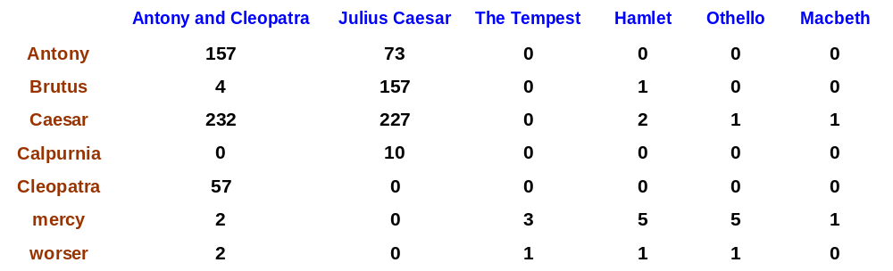
Term-document count matrices
Sec. 6.2
Consider the number of occurrences of a term in a document:
  Each document is a count vector : a column below

Slide 13
Bag of words model
Vector representation doesn’t consider the ordering of words in a document
John is quicker than Mary and Mary is quicker than John have the same vectors
This is called the bag of words model.
In a sense, this is a step back: The positional index was able to distinguish these two documents.
We will look at “recovering” positional information later in this course.
For now: bag of words model

Slide 14
Term frequency tf
The term frequency tf_{t,d} of term t in document d is defined as the number of times that t occurs in d.
We want to use tf when computing query-document match scores. But how?
Raw term frequency is not what we want:
  A document with 10 occurrences of the term is more relevant than a document with 1 occurrence of the term.
  But not 10 times more relevant.
Relevance does not increase proportionally with term frequency.
NB: frequency = count in IR

Slide 15
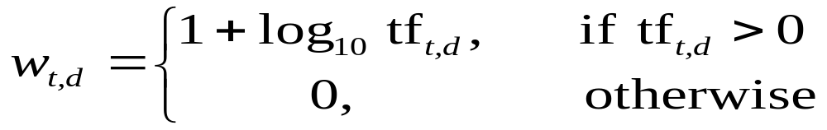

Log-frequency weighting
Sec. 6.2
The log frequency weight of term t in d is
0 → 0, 1 → 1, 2 → 1.3, 10 → 2, 1000 → 4, etc.
Score for a document-query pair: sum over terms t in both q and d:
score
The score is 0 if none of the query terms is present in the document.
Notes:
overlap score measure

Slide 16
Document frequency
Sec. 6.2.1
Rare terms are more informative than frequent terms
  Recall stop words
→ We want a high weight for rare terms.

Slide 17
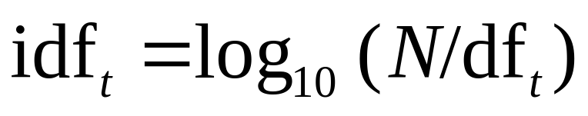
idf weight
Sec. 6.2.1
df_{t} is the document frequency of t: the number of documents that contain t
  df_{t} is an inverse measure of the informativeness of t
  df_{t} ≤ N
We define the idf (inverse document frequency) of t by
  We use log (N/df_{t}) instead of N/df_{t} to “dampen” the effect of idf.
Will turn out the base of the log is immaterial.

Slide 18
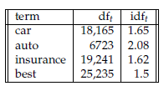
idf example, suppose N = 806791
Sec. 6.2.1
There is one idf value for each term t in a collection.
Notes:
6 4 3 2 1 0

Slide 19
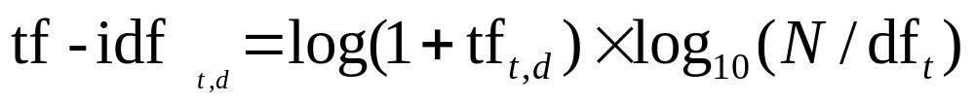
tf-idf weighting
Sec. 6.2.2
The tf-idf weight of a term is the product of its tf weight and its idf weight.
Best known weighting scheme in information retrieval
  Note: the “-” in tf-idf is a hyphen, not a minus sign!
  Alternative names: tf.idf, tf x idf
Increases with the number of occurrences within a document
Increases with the rarity of the term in the collection

Slide 20

Binary → count → tf-idf weight matrix
Sec. 6.3
Each document is now represented by a real-valued vector of tf-idf

Slide 21
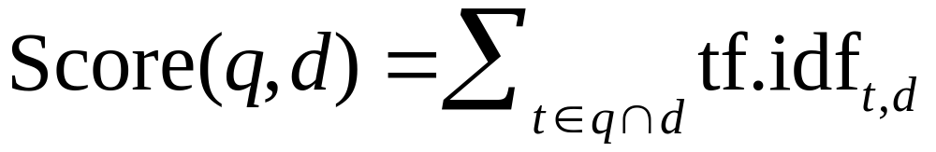
Score for a document given a query
Sec. 6.2.2
There are many variants
  How “tf” is computed (with/without logs)
  Whether the terms in the query are also weighted
  …

Slide 22
The Vector Space Model for Scoring
Sec. 6.3
The set of documents in a collection may be viewed as a set of vectors in a vector space.
  Terms are axes of the space
  Documents are points or vectors in this space
Very high-dimensional: tens of millions of dimensions when you apply this to a web search engine
These are very sparse vectors - most entries are zero.

Slide 23
Vector Similarity
How do we quantify the similarity between two documents in this vector space?
A first attempt : the magnitude of the vector difference between two document vectors.
  Drawback: two documents with very similar content can have a significant vector difference simply because one is much longer than the other.
Solution to compensate for the effect of document length is to compute the cosine similarity.

Slide 24


Cosine similarity illustrated

Slide 25
From angles to cosines
Sec. 6.3
The following two notions are equivalent.
  Rank documents in decreasing order of the angle between query and document
  Rank documents in increasing order of cosine(query,document)
Cosine is a monotonically decreasing function for the interval [0º, 180º]

Slide 26

cosine(document,document)
Sec. 6.3
DOT PRODUCT
(2)
EUCLIDEAN LENGTH
Notes:
See Law of Cosines (Cosine Rule) wikipedia page

Slide 27
Cosine for length-normalized vectors
(2)
Then we can rewrite the previous equation as:
(3)

Slide 28
Example: N= 1,000,000
Sec. 6.4
Document: car insurance auto insurance
Query: best car insurance
Term | DF
auto | 5000
best | 50000
car | 10000
insurance | 1000

Slide 29
Example: N= 1,000,000
Sec. 6.4
Document: car insurance auto insurance
Query: best car insurance
Term | Query |  |  |  |  |  | Document |  |  |  | Prod
auto
best
car
insurance

Slide 30
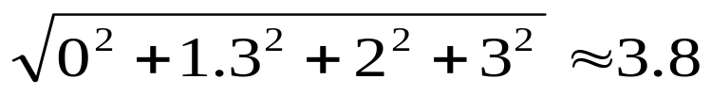
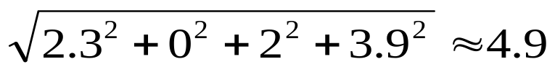
Example: N= 1,000,000
Sec. 6.4
Document: car insurance auto insurance
Query: best car insurance
Term | Query |  |  |  |  |  | Document |  |  |  | Prod
 | tf-raw
auto | 0
best | 1
car | 1
insurance | 1
Term | Query |  |  |  |  |  | Document |  |  |  | Prod
 | tf-raw | tf-wt
auto | 0 | 0
best | 1 | 1
car | 1 | 1
insurance | 1 | 1
Term | Query |  |  |  |  |  | Document |  |  |  | Prod
 | tf-raw | tf-wt | df
auto | 0 | 0 | 5000
best | 1 | 1 | 50000
car | 1 | 1 | 10000
insurance | 1 | 1 | 1000
Term | Query |  |  |  |  |  | Document |  |  |  | Prod
 | tf-raw | tf-wt | df | idf
auto | 0 | 0 | 5000 | 2.3
best | 1 | 1 | 50000 | 1.3
car | 1 | 1 | 10000 | 2.0
insurance | 1 | 1 | 1000 | 3.0
Term | Query |  |  |  |  |  | Document |  |  |  | Prod
 | tf-raw | tf-wt | df | idf | wt
auto | 0 | 0 | 5000 | 2.3 | 0
best | 1 | 1 | 50000 | 1.3 | 1.3
car | 1 | 1 | 10000 | 2.0 | 2.0
insurance | 1 | 1 | 1000 | 3.0 | 3.0
Term | Query |  |  |  |  |  | Document |  |  |  | Prod
 | tf-raw | tf-wt | df | idf | wt | n’lize
auto | 0 | 0 | 5000 | 2.3 | 0 | 0
best | 1 | 1 | 50000 | 1.3 | 1.3 | 0.34
car | 1 | 1 | 10000 | 2.0 | 2.0 | 0.53
insurance | 1 | 1 | 1000 | 3.0 | 3.0 | 0.79
Term | Query |  |  |  |  |  | Document |  |  |  | Prod
 | tf-raw | tf-wt | df | idf | wt | n’lize | tf-raw | tf-wt | wt
auto | 0 | 0 | 5000 | 2.3 | 0 | 0 | 1 | 1 | 2.3
best | 1 | 1 | 50000 | 1.3 | 1.3 | 0.34 | 0 | 0 | 0
car | 1 | 1 | 10000 | 2.0 | 2.0 | 0.53 | 1 | 1 | 2.0
insurance | 1 | 1 | 1000 | 3.0 | 3.0 | 0.79 | 2 | 1.3 | 3.9
Term | Query |  |  |  |  |  | Document |  |  |  | Prod
 | tf-raw | tf-wt | df | idf | wt | n’lize | tf-raw | tf-wt | wt | n’lize
auto | 0 | 0 | 5000 | 2.3 | 0 | 0 | 1 | 1 | 2.3 | 0.47
best | 1 | 1 | 50000 | 1.3 | 1.3 | 0.34 | 0 | 0 | 0 | 0
car | 1 | 1 | 10000 | 2.0 | 2.0 | 0.53 | 1 | 1 | 2.0 | 0.41
insurance | 1 | 1 | 1000 | 3.0 | 3.0 | 0.79 | 2 | 1.3 | 3.9 | 0.80
Term | Query |  |  |  |  |  | Document |  |  |  | Prod
 | tf-raw | tf-wt | df | idf | wt | n’lize | tf-raw | tf-wt | wt | n’lize
auto | 0 | 0 | 5000 | 2.3 | 0 | 0 | 1 | 1 | 2.3 | 0.47 | 0
best | 1 | 1 | 50000 | 1.3 | 1.3 | 0.34 | 0 | 0 | 0 | 0 | 0
car | 1 | 1 | 10000 | 2.0 | 2.0 | 0.53 | 1 | 1 | 2.0 | 0.41 | 0.22
insurance | 1 | 1 | 1000 | 3.0 | 3.0 | 0.79 | 2 | 1.3 | 3.9 | 0.80 | 0.63
Query length =
Doc length =
Score = 0+0+0.22+0.63 = 0.85

